Slide 1
CAT-NAP
Sandra Alegría, Matias Araya, Oscar Castro, Pablo González, Javier Mier

Slide 2
WHAT THE GAME IS ABOUT
01

Slide 3
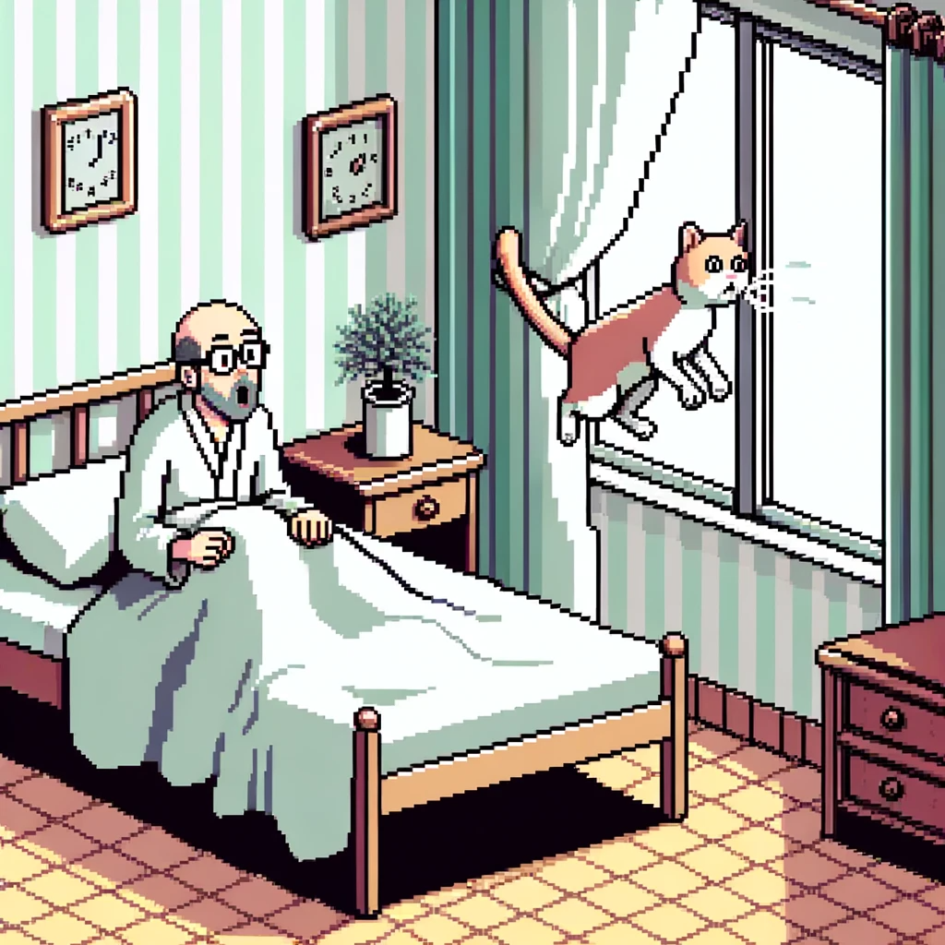
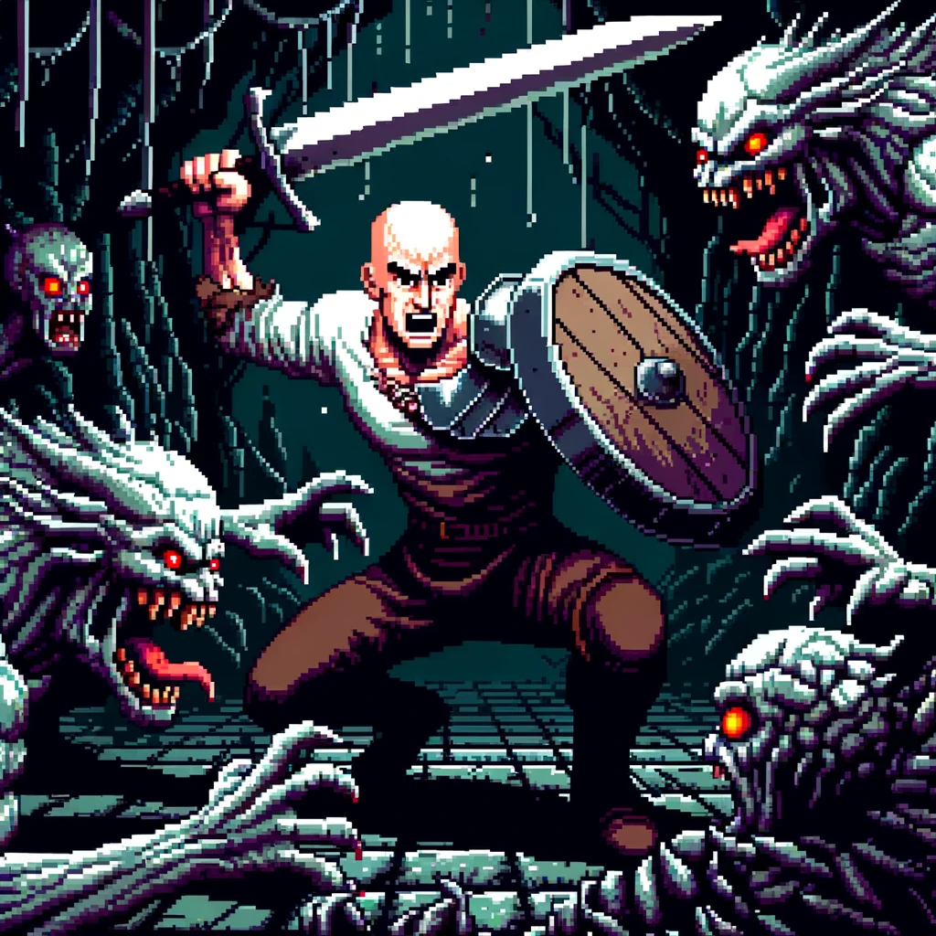
Notes:
Me encanta

Slide 4
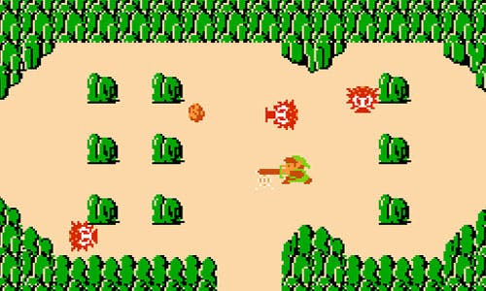
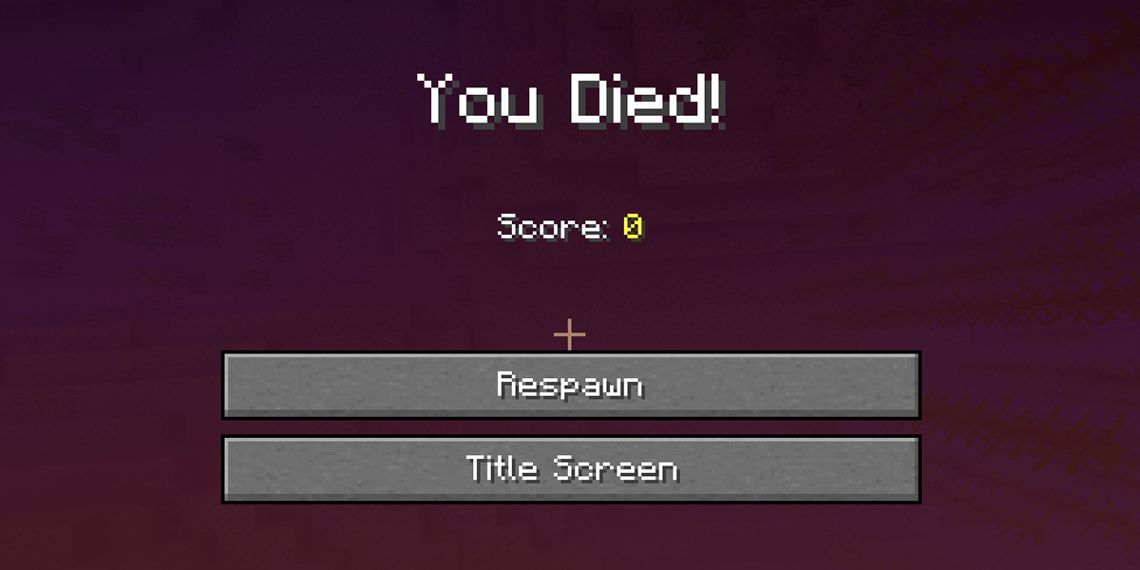


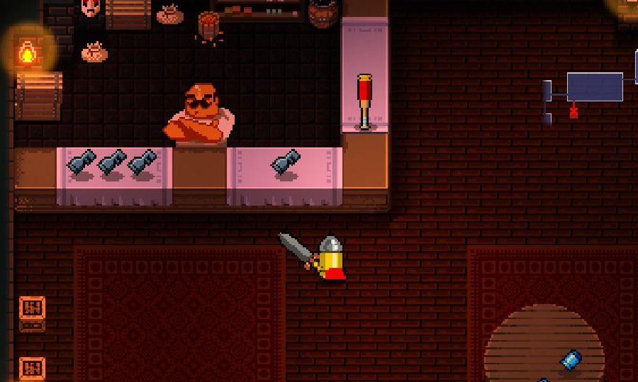
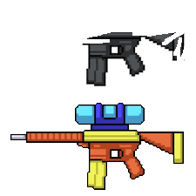

Slide 5
GAME PRESENTATION
02

Slide 6
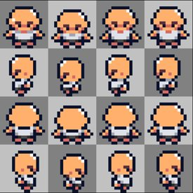

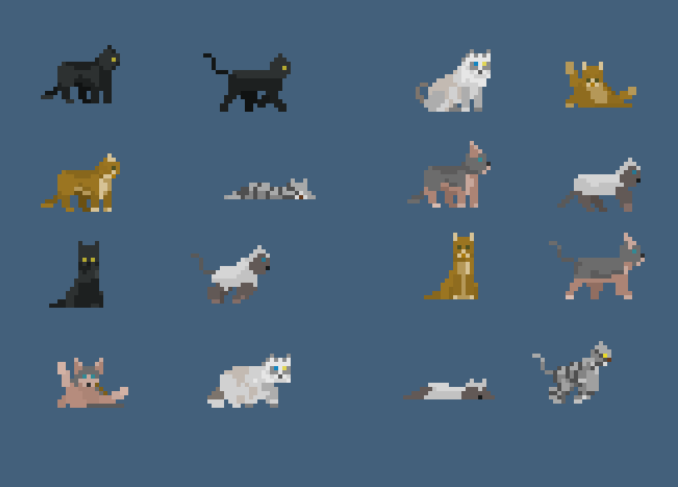

Slide 7
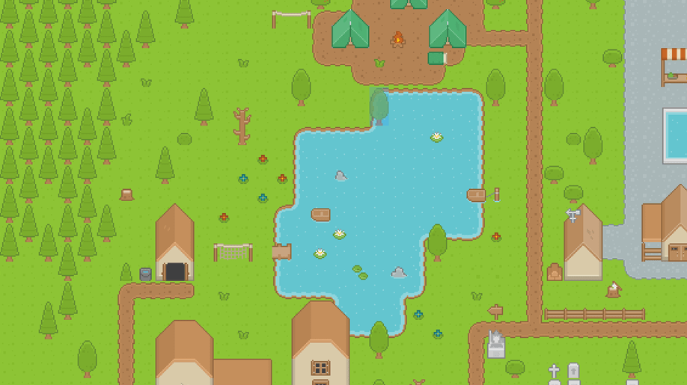
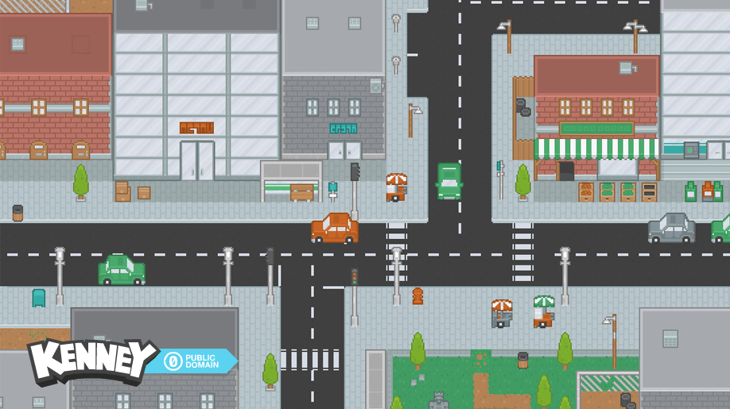

Slide 8
TOOLS AND DEVELOPEMENT PLAN
03

Slide 9






Game engine:
Graphic design:
Version control:
Planning:
Music:

Slide 10
Programming
Player | Pablo
Items | Pablo
Enemies | Sandra
Game Boss | Matías
Maps/Levels | Javi and Oscar
Interfaces | ?
Desing
Art and animations | All
Visual effects | All
Music | All
Sound effects | All

